Slide 1
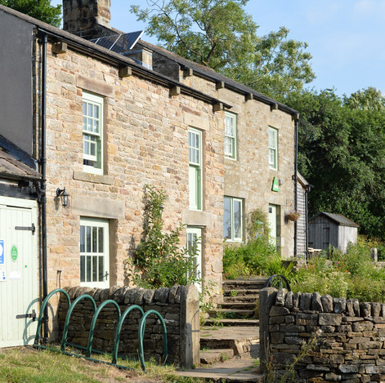
Hot Shots
This Photo by Unknown author is licensed under CC BY-SA.

Slide 2
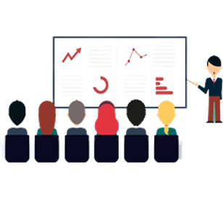
Contents
Our team
Our goal
The technologies we use are
What are we planning for the features?
Stages of development

Slide 3
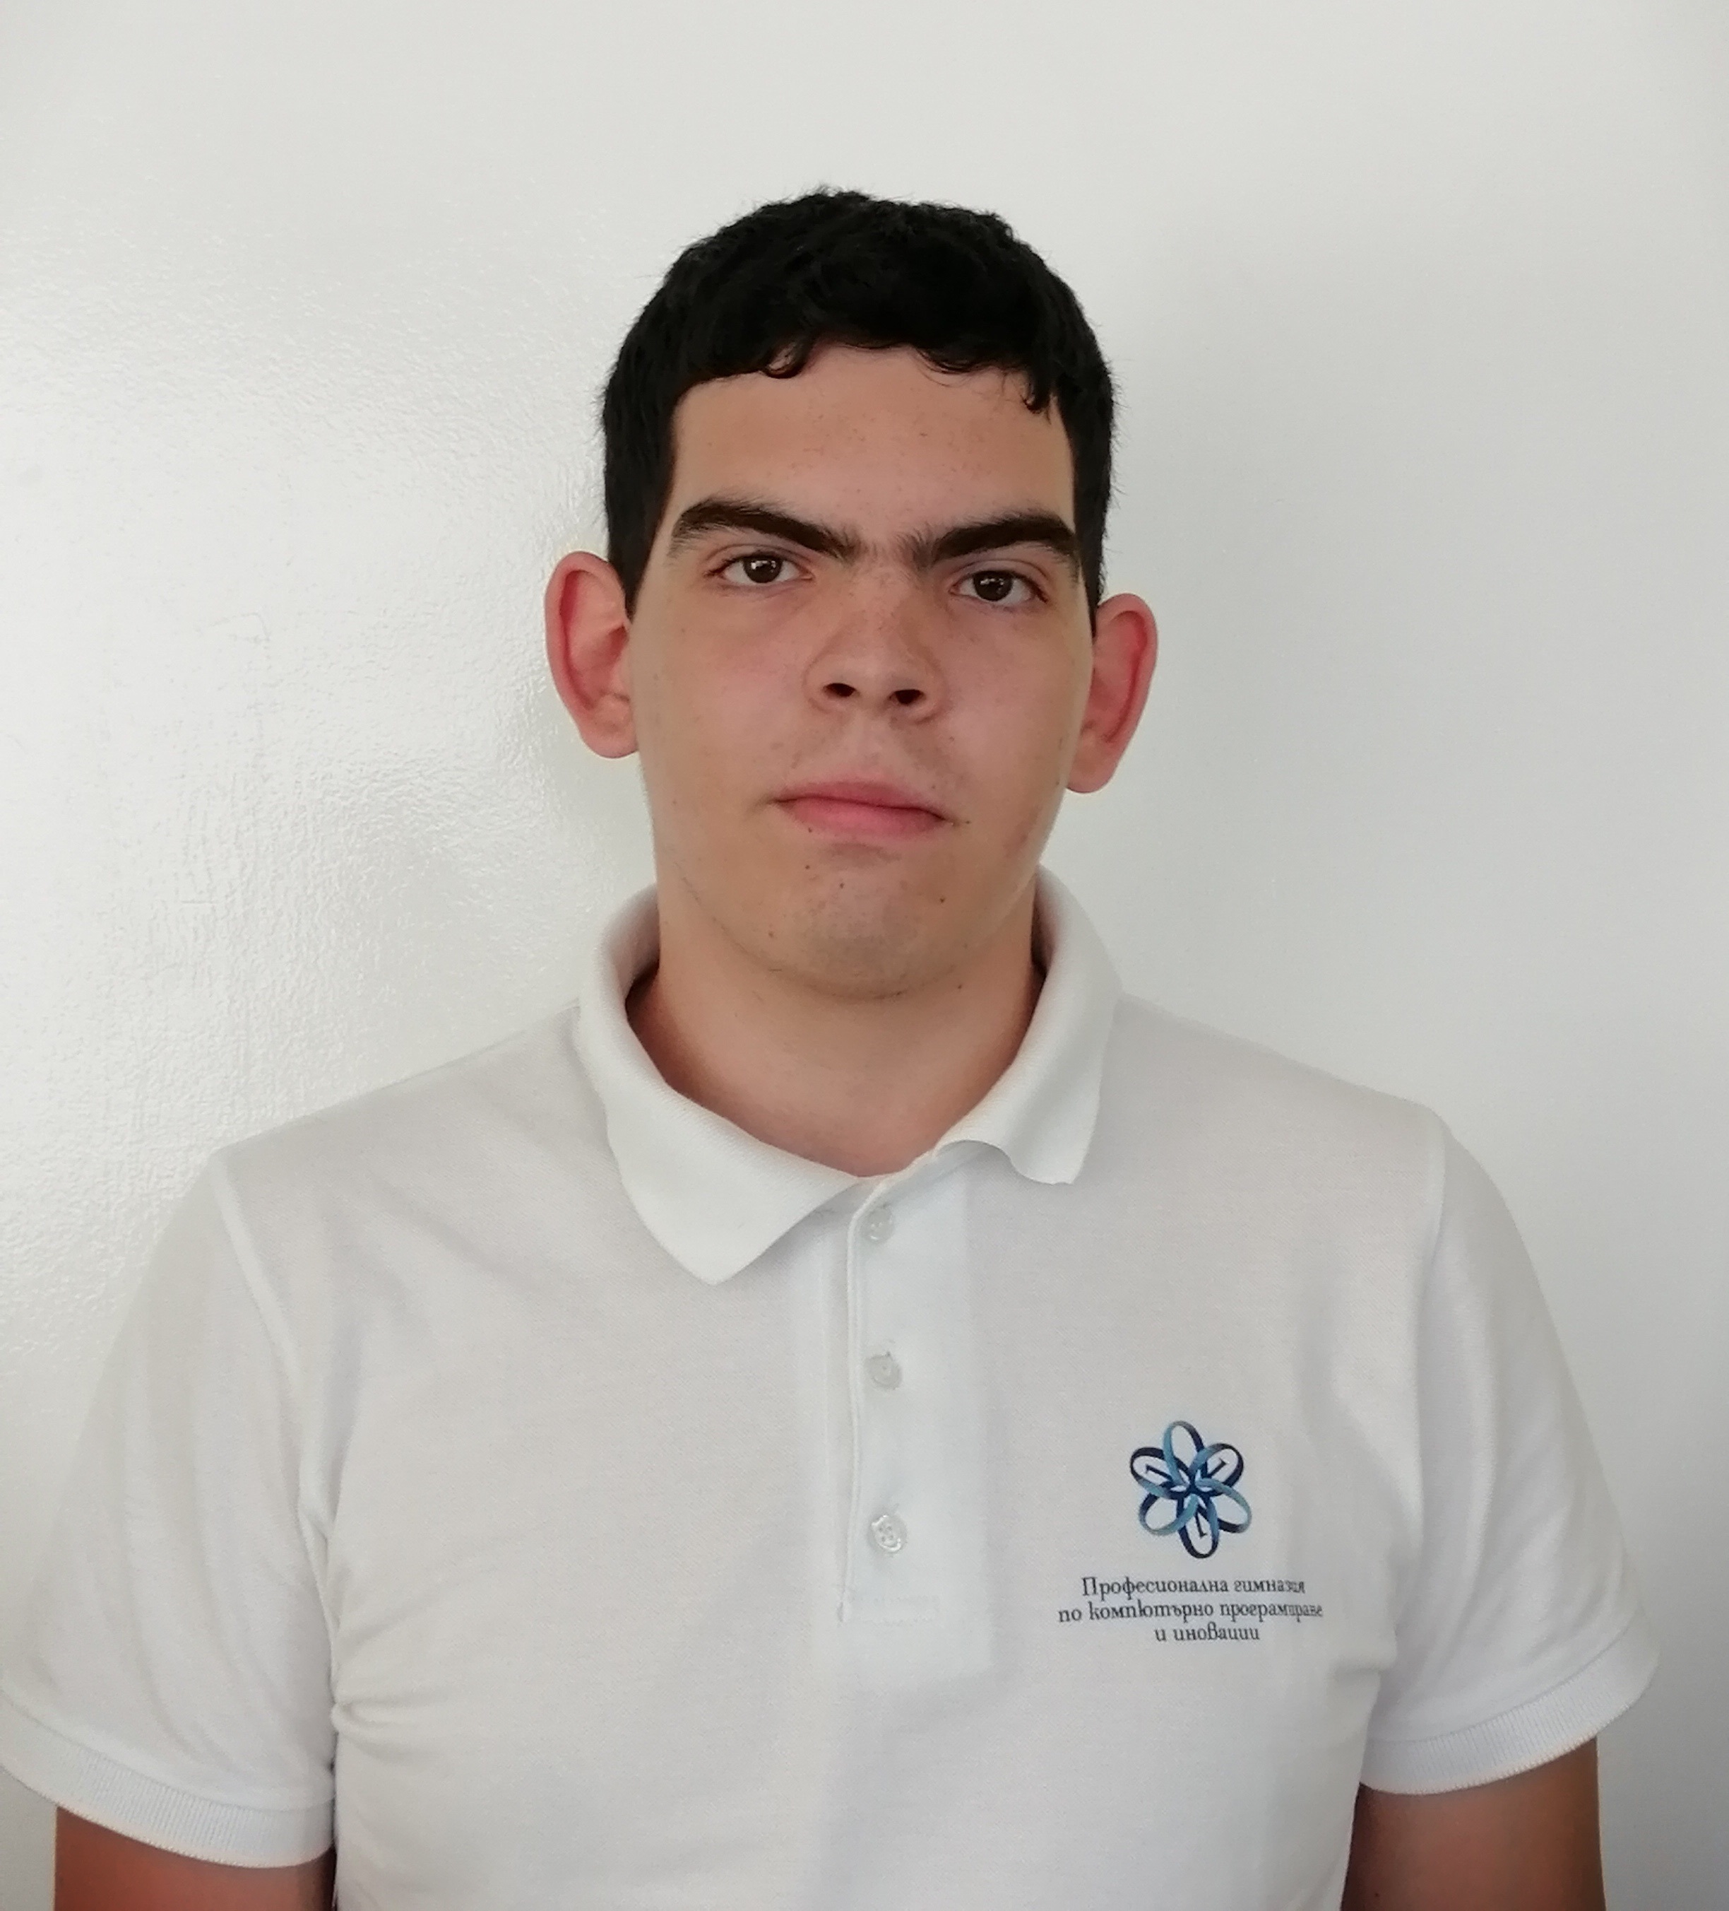
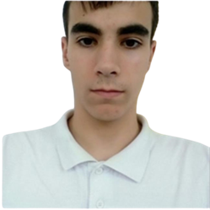
Our team
Ivo Dimov
Todor Bozhinov

Slide 4

Our goal:
Our reading is from creating an application for managing a dormitory application to a school.
It will allow applications to be sorted and searched for by parents according to certain criteria.

Slide 5


Stages of development:
Discuss the project
Implement menus
Implement main functions
Separate the code into files
Make documentations
Finish the project

Slide 6







Used technologies

Slide 7

Future goals:
Option for user feedback
Update our menus
Update our functions
Finish our app

Slide 8


